Slide 1
Design Verification Oct 2018 Final Project

Slide 2
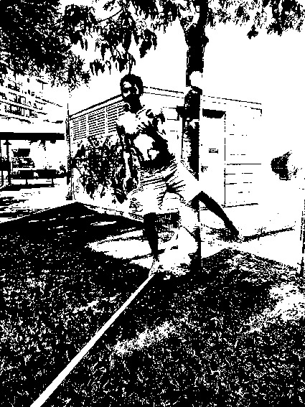
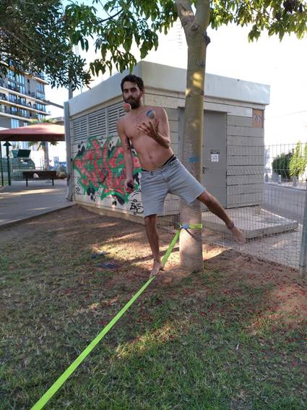

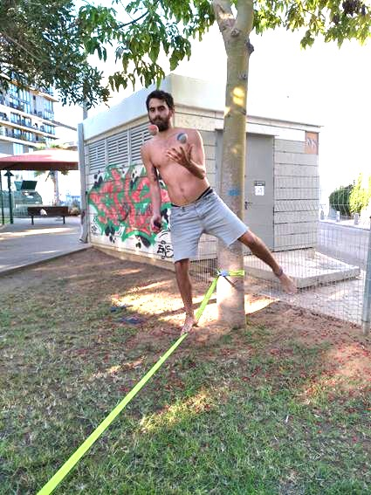
Image Processing Acclerator

Slide 3
Block features
Two main features:
Threshold
Brightness
More features might be added – according to your progress
Image format of 24-bit BMP (Microsoft Windows BMP image file)
Might support other formats – according to progress
Data bus is configurable – 32 bits / 64 bits

Slide 4
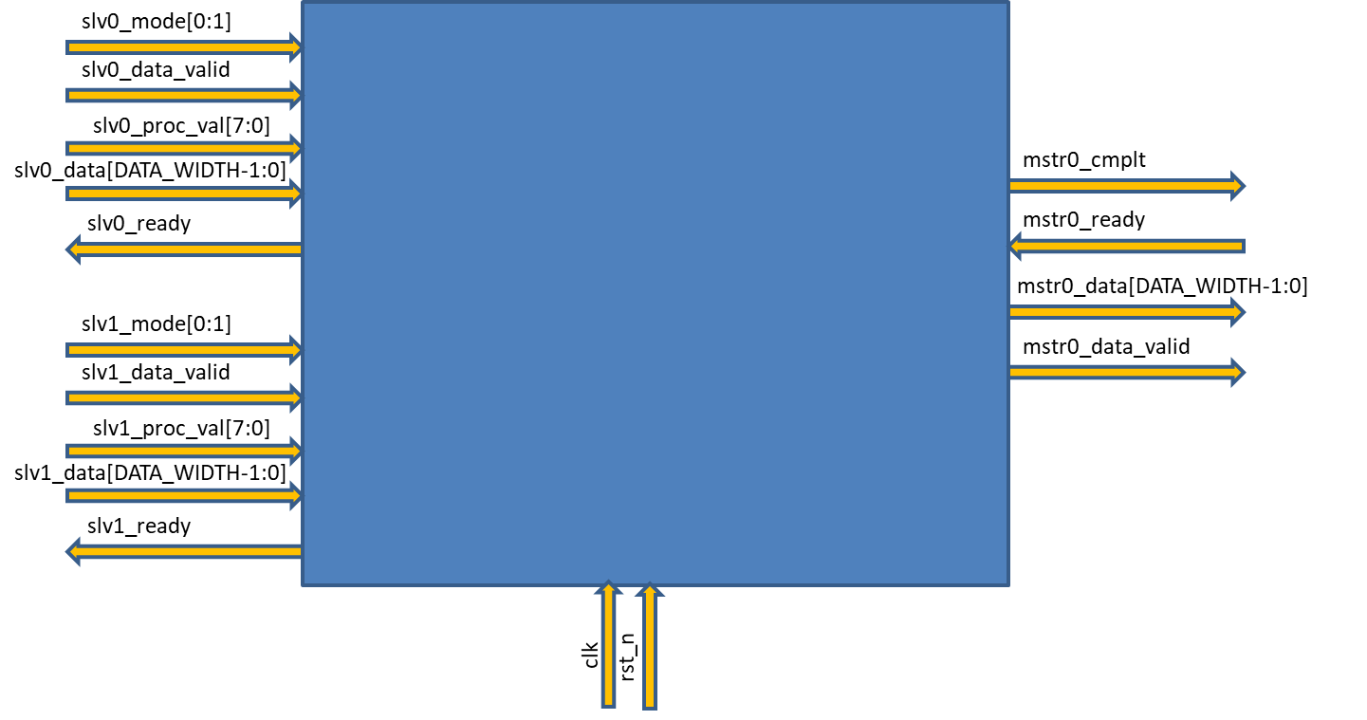
Block Interfaces

Slide 5
Personal Challenge
You will work in teams (2-3 in a team).
You decide with whom to work
Block implementation using Verilog
Full verification environment development using SystemVerilog & UVM
Automation scripts using Perl or/and Python
You will have many checkpoints on the way to help guide you through the project
Industry partners will come to mentor

Slide 6
Goals
Practice your acquired knowledge
Personal achievement to show for future employers
Learn how to manage time and tasks in a full-cycle project
Gain extra knowledge in every related aspect
Practice the interaction between Design, Arch and Verification

Slide 7
Getting started
Convert your data to HEX.
http://tomeko.net/online_tools/file_to_hex.php?lang=en
Create a script that converts BMP to HEX
Leverage familiar blocks - fifo, arbiters, etc.
Use header info – size of file, width, height, etc.
Ask questions! Spec is not fully detailed…

Slide 8
project planning
First simulations
Project closure
Basic design plan
Verification plan
Verification environment is working and running
Relevant scripts are available for usage
Relevant docs are available
2-3 days
5-7 days
~2 days
2-4 days
1-2 days
First release of Verilog files
Verification signoff
Blocks are ready first simulations
100% pass rate
100% coverage
www.free-powerpoint-templates-design.com

Slide 9
Checkpoint 1: Teams ready and planning done
Choose your partners
Plan your block and sub-blocks
Have a first and stable version of the verification plan
Set responsibilities for each team member!

Slide 10
Checkpoint 2: Design ready for first sim
Sub-blocks are ready for testing
Plan together the interface between the sub-blocks
Sub-blocks interfaces are documented
Always think in verification aspects

Slide 11
Checkpoint 3: Verification env ready
Plan your environment and implement
Update the verification accordingly
Communicate with each other – you either the designer of block A or the verification engineer of block B
Plan and implement any script that might help you

Slide 12
Checkpoint 4: Design fully verified
All the tests, coverage and other goals are reached
Add more coverage
Add more random tests! We can’t think of all the necessary coverage..
Consider adding more features to the block

Slide 13
Project Requirements
Should be an end-to-end project
Involve thinking as architect, design engineer and mostly verification engineer
Many documents to handle
Self research is required
Team work is crucial

Slide 14
Tips
Plan carefully before implementing
Always think about potential verification struggles
Communicate with each other and with other teams
Use the internet for research
Raise questions to me

Slide 15
Next checkpoint
Decide on the teams and create first project planning document by Wednesday (January 16)

